Slide 1
Module4_Process Synchronization
Reference: “OPERATING SYSTEM CONCEPTS”, ABRAHAM SILBERSCHATZ, PETER BAER GALVIN, GREG GAGNE , Wiley publications.

Slide 2
Process Synchronization
Background
The Critical-Section Problem
Peterson’s Solution
Synchronization Hardware
Mutex Locks
Semaphores
Classic Problems of Synchronization
Monitors

Slide 3
Objectives
To present the concept of process synchronization.
To introduce the critical-section problem, whose solutions can be used to ensure the consistency of shared data
To present both software and hardware solutions of the critical-section problem
To examine several classical process-synchronization problems
To explore several tools that are used to solve process synchronization problems

Slide 4
Background
A cooperating process is one that can affect or be affected by other processes executing in the system.
Processes can execute concurrently
  May be interrupted at any time, partially completing execution
Concurrent access to shared data may result in data inconsistency
Maintaining data consistency requires mechanisms to ensure the orderly execution of cooperating processes
Illustration of the problem:
Suppose that we wanted to provide a solution to the Producer-Consumer problem that fills all the buffers. We can do so by having an integer counter that keeps track of the number of full buffers. Initially, counter is set to 0. It is incremented by the producer after it produces a new buffer and is decremented by the consumer after it consumes a buffer.

Slide 5
Producer
while (true) {
/* produce an item in next_produced */
while (counter == BUFFER_SIZE) ;
/* do nothing */
buffer[in] = next_produced;
in = (in + 1) % BUFFER_SIZE;
counter++;
}
//Old version of Producer
item next_produced;
while (true) {
/* produce an item in next produced */
while (((in + 1) % BUFFER_SIZE) == out)
; /* do nothing */
buffer[in] = next_produced;
in = (in + 1) % BUFFER_SIZE;
}
        x

Slide 6
Consumer
while (true) {
while (counter == 0);
/* do nothing */
next_consumed = buffer[out];
out = (out + 1) % BUFFER_SIZE; counter--;
/* consume the item in next_consumed */
}

Slide 7
Race Condition - Example
Race Condition: A situation where several processes access and manipulate the same data concurrently and the outcome of the execution depends on the particular order in which the access takes place, is called a race condition.
  Solution: Ensure that only one process at a time can be manipulating the variable counter which requires that the processes be synchronized in some way.
counter++ could be implemented as
register1 = counter
register1 = register1 + 1
counter = register1
counter-- could be implemented as
register2 = counter
register2 = register2 - 1
counter = register2
Consider this execution interleaving with “counter = 5” initially:
  T0: producer executes register1 = counter {register1 = 5}
  T1: producer executes register1 = register1 + 1 {register1 = 6}
  T2: consumer executes register2 = counter {register2 = 5}
  T3: consumer executes register2 = register2 – 1 {register2 = 4}
  T4: producer executes counter = register1 {counter = 6 }
  T5: consumer executes counter = register2 {counter = 4}

Slide 8
Critical Section Problem
Consider system of n processes {p₀, p₁, … p_{n-1}}
Each process has critical section segment of code
  Process may be
    changing common variables
    Updating a shared memory block
    updating table
    writing file, … etc
  When one process is in critical section, no other may be in its critical section
    no two processes are executing in their critical sections at the same time.
Critical section problem is to design protocol that the processes can use to cooperate
Each process must ask permission to enter critical section in entry section, may follow critical section with exit section, then remainder section

Slide 9
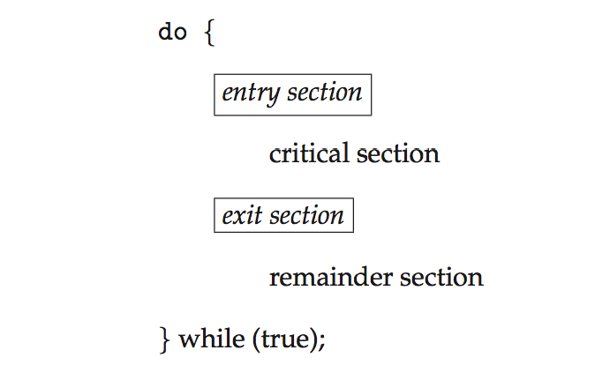
Critical Section
General structure of process P_{i}

Slide 10
Solution to Critical-Section Problem
A solution to the critical-section problem must satisfy the following three requirements:
Mutual Exclusion - If process P_{i} is executing in its critical section, then no other processes can be executing in their critical sections
Progress - If no process is executing in its critical section and there exist some processes that wish to enter their critical section, then the selection of the processes that will enter the critical section next cannot be postponed indefinitely.
  Only those processes that are not executing in their remainder sections can participate in deciding which will enter its critical section next
3. Bounded Waiting - A bound must exist on the number of times that other processes are allowed to enter their critical sections after a process has made a request to enter its critical section and before that request is granted.
  Assume that each process executes at a nonzero speed
  No assumption concerning relative speed of the n processes

Slide 11
Algorithm for Process P_{i}
do {
while (turn == j);
critical section
turn = j;
remainder section
} while (true);
Process 0, P0 | Process 1, P1
do { while (turn ==1); critical section turn =1; remainder section } while (true); | do { while (turn == 0); critical section turn = 0; remainder section } while (true);

Slide 12
Solution to Critical-Section Problem
A solution to the critical-section problem must satisfy the following three requirements:
Mutual Exclusion - If process P_{i} is executing in its critical section, then no other processes can be executing in their critical sections
Progress - If no process is executing in its critical section and there exist some processes that wish to enter their critical section, then the selection of the processes that will enter the critical section next cannot be postponed indefinitely.
  Only those processes that are not executing in their remainder sections can participate in deciding which will enter its critical section next
3. Bounded Waiting - A bound must exist on the number of times that other processes are allowed to enter their critical sections after a process has made a request to enter its critical section and before that request is granted.
  Assume that each process executes at a nonzero speed
  No assumption concerning relative speed of the n processes

Slide 13
Critical-Section Handling in OS
Two approaches depending on if kernel is preemptive or non- preemptive
  Preemptive – allows preemption of process when running in kernel mode
  Non-preemptive – runs until exits kernel mode, blocks, or voluntarily yields CPU
    Essentially free of race conditions in kernel mode

Slide 14
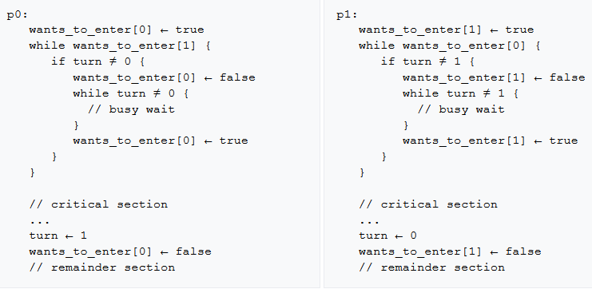
Dekker's Algorithm
Dekker's algorithm is the first known correct solution to the mutual exclusion problem. The solution is attributed to Dutch mathematician Th. J. Dekker by Edsger W. Dijkstra.
  Variables
      wants_to_enter : array of 2 booleans
      turn : integer
      wants_to_enter[0] ← false
      wants_to_enter[1] ← false
      turn ← 0 // or 1

Slide 15
Peterson’s Solution
Good algorithmic description of solving the problem
Two process solution
The two processes share two variables:
  int turn;
  Boolean flag[2]
The variable turn indicates whose turn it is to enter the critical section
The flag array is used to indicate if a process is ready to enter the critical section. flag[i] = true implies that process P_{i} is ready.

Slide 16
Algorithm for Process P_{i}
do {
flag[i] = true;
turn = j;
while (flag[j] && turn = = j);
critical section
flag[i] = false;
remainder section
} while (true);
Process i, Pi | Process j, Pj
do { flag[i] = true; turn = j; while (flag[j] && turn = = j); critical section flag[i] = false; remainder section } while (true); | do { flag[j] = true; turn = i; while (flag[i] && turn = = i); critical section flag[j] = false; remainder section } while (true);

Slide 17
Peterson’s Solution (Cont.)
To enter the critical section, process Pi first sets flag[i] to be true and then sets turn to the value j, thereby asserting that if the other process wishes to enter the critical section, it can do so.
If both processes try to enter at the same time, turn will be set to both i and j at roughly the same time.
  Only one of these assignments will last; the other will occur but will be overwritten immediately.
The eventual value of turn determines which of the two processes is allowed to enter its critical section first.

Slide 18
Peterson’s Solution (Cont.)
Provable that the three CS requirements are met:
1. Mutual exclusion is preserved
P_{i} enters CS only if:
either flag[j] = false or turn = i
2. Progress requirement is satisfied:
  Process Pi can be prevented from entering the critical section only if it is stuck in the while loop with the condition flag[j] == true and turn == j; this loop is the only one possible.
  If Pj is not ready to enter the critical section, then flag[j] == false, and Pi can enter its critical section.
  If Pj has set flag[j] to true and is also executing in its while statement, then either turn == i or turn == j. If turn == i, then Pi will enter the critical section. If turn == j, then Pj will enter the critical section. However, once Pj exits its critical section, it will reset flag[j] to false, allowing Pi to enter its critical section.
  3. Bounded-waiting requirement is met
    If Pj resets flag[j] to true, it must also set turn to i. Thus, since Pi does not change the value of the variable turn while executing the while statement, Pi will enter the critical section (progress) after at most one entry by Pj (bounded waiting).

Slide 19
Synchronization Hardware
Many systems provide hardware support for implementing the critical section code.
All solutions are based on idea of locking
  Protecting critical regions via locks
Hardware features can make any programming task easier and improve system efficiency.
Uniprocessors – could disable interrupts
  Currently running code would execute without preemption
  Generally too inefficient on multiprocessor systems
    Operating systems using this not broadly scalable
Modern machines provide special atomic hardware instructions
    Atomic = non-interruptible
  Either test memory word and set value
  Or swap contents of two memory words

Slide 20
Solution to Critical-section Problem Using Locks
do {
acquire lock
critical section
release lock
remainder section
} while (TRUE);
//General flow as given above

Slide 21
test_and_set Instruction
Definition:
boolean test_and_set (boolean *target)
{
boolean rv = *target;
*target = TRUE;
return rv:
}
Executed atomically
Returns the original value of passed parameter
Set the new value of passed parameter to “TRUE”.

Slide 22
Solution using test_and_set()
Shared Boolean variable lock, initialized to FALSE
Solution - Mutual-exclusion implementation with test and set():
do {
while (test_and_set(&lock))
; /* do nothing */
/* critical section */
lock = false;
/* remainder section */
} while (true);
boolean test_and_set (boolean *target)
{
boolean rv = *target;
*target = TRUE;
return rv:
}

Slide 23
compare_and_swap Instruction
Definition:
int compare_and_swap(int *value, int expected, int new_value) {
int temp = *value;
if (*value == expected)
*value = new_value;
return temp;
}
Executed atomically
Returns the original value of passed parameter “value”
Set the variable “value” the value of the passed parameter “new_value” but only if “value” ==“expected”. That is, the swap takes place only under this condition.

Slide 24
Solution using compare_and_swap
Shared integer “lock” is initialized to 0.
Solution-Mutual-exclusion implementation with the compare and swap() instruction:
do {
while (compare_and_swap(&lock, 0, 1) != 0)
; /* do nothing */
/* critical section */
lock = 0;
/* remainder section */
} while (true);
//////////////////////////////////////////////////////////////
int compare_and_swap(int *value, int expected, int new_value) {
int temp = *value;
if (*value == expected)
*value = new_value;
return temp;
}

Slide 25
Bounded-waiting Mutual Exclusion with test_and_set
do {
waiting[i] = true;
key = true;
while (waiting[i] && key)
key = test_and_set(&lock);
waiting[i] = false;
/* critical section */
j = (i + 1) % n;
while ((j != i) && !waiting[j])
j = (j + 1) % n;
if (j == i)
lock = false;
else
waiting[j] = false;
/* remainder section */
} while (true);

Slide 26
Mutex Locks
Previous solutions are complicated and generally inaccessible to application programmers
OS designers build software tools to solve critical section problem
Simplest is mutex lock
Protect a critical section by first acquire() a lock then release() the lock
  Boolean variable indicating if lock is available or not
Calls to acquire() and release() must be atomic
  Usually implemented via hardware atomic instructions
But this solution requires busy waiting
  This lock therefore called a spinlock

Slide 27
acquire() and release()
acquire() {
while (!available)
; /* busy wait */
available = false;;
}
release() {
available = true;
}
do {
acquire lock
critical section
release lock
remainder section
} while (true);

Slide 28
Semaphore
Synchronization tool that provides more sophisticated ways (than Mutex locks) for process to synchronize their activities.
Semaphore S – integer variable
  Can only be accessed via two indivisible (atomic) operations
  wait() and signal()
    Originally called P() and V()
Definition of the wait() operation
  wait(S) {
  while (S <= 0)
  ; // busy wait
  S--;
  }
Definition of the signal() operation
  signal(S) {
  S++;
  }

Slide 29
Semaphore Usage
Counting semaphore – integer value can range over an unrestricted domain
Binary semaphore – integer value can range only between 0 and 1
  Same as a mutex lock
Can solve various synchronization problems
Consider two concurrently running processes P₁ and P₂ that require S₁ to happen before S₂
Create a semaphore “synch” initialized to 0
  P1:
  S₁;
  signal(synch);
  P2:
  wait(synch);
  S₂;
Can implement a counting semaphore S as a binary semaphore

Slide 30
Semaphore Implementation
Must guarantee that no two processes can execute the wait() and signal() on the same semaphore at the same time
Thus, the implementation becomes the critical section problem where the wait and signal code are placed in the critical section
  Could now have busy waiting in critical section implementation
    But implementation code is short
    Little busy waiting if critical section rarely occupied
But many applications may spend lots of time in critical sections and therefore this is not a good solution

Slide 31
Semaphore Implementation with no Busy waiting
With each semaphore there is an associated waiting queue
Each entry in a waiting queue has two data items:
  value (of type integer)
  pointer to next record in the list
Two operations:
  block – place the process invoking the operation on the appropriate waiting queue
  wakeup – remove one of the processes in the waiting queue and place it in the ready queue
typedef struct{
int value;
struct process *list;
} semaphore;

Slide 32
Implementation with no Busy waiting (Cont.)
wait(semaphore *S) {
S->value--;
if (S->value < 0) {
add this process to S->list;
block();
}
}
signal(semaphore *S) {
S->value++;
if (S->value <= 0) {
remove a process P from S->list;
wakeup(P);
}
}

Slide 33
Semaphore Example
// WRT the modified wait and signal implementation:
Semaphore *s1, *s2;
s1 = new Semaphore(1); // s1->value = 1
s2 = new Semaphore(2); // s2->value = 2
// Assume a system of 3 cooperating processes and the pseudocode snippets given below:
// After the execution of the snippets according to the given timeline , the state of s1 and s2 would be as follows
// P3 waits on s2 …
s1->value = 1 , s1->list = NULL
s2->value = -1 , s2->list -> P3
Process P1 | Process P2 | Process P3
wait ( s2 ) ; wait ( s1 ) ; …. signal ( s1 ) ; | wait( s2) ; wait ( s1 ) ; …. signal ( s1 ) ; | wait ( s2 ) ; wait ( s1 ) ; …. signal ( s1 ) ;

Slide 34
Semaphore Example (cont’d)
// Adding to previous pseudocode snippets
// Now the state of s1 and s2 would be as follows
s1->value = 1 , s1->list = NULL
s2->value = 2 , s2->list -> NULL
Process P1 | Process P2 | Process P3
wait ( s2 ) ; wait ( s1 ) ; …. signal ( s1 ) ; signal ( s2 ) ; | wait( s2) ; wait ( s1 ) ; …. signal ( s1 ) ; signal ( s2 ); | wait ( s2 ) ; wait ( s1 ) ; …. signal ( s1 ) ; signal ( s2 );

Slide 35
Deadlock and Starvation
Deadlock – two or more processes are waiting indefinitely for an event that can be caused by only one of the waiting processes
Let S and Q be two semaphores initialized to 1
P₀ P₁
wait(S); wait(Q);
wait(Q); wait(S);
... ...
signal(S); signal(Q);
signal(Q); signal(S);
Starvation – indefinite blocking
  A process may never be removed from the semaphore queue in which it is suspended
Priority Inversion – Scheduling problem when lower-priority process (L) holds a lock needed by higher-priority process (H)
  Solved through priority-inheritance protocol

Slide 36
Classical Problems of Synchronization
Classical problems used to test newly proposed synchronization schemes
  Bounded-Buffer Problem
  Readers and Writers Problem
  Dining-Philosophers Problem

Slide 37
Bounded-Buffer Problem
n buffers, each can hold one item
Semaphore mutex initialized to the value 1
Semaphore full initialized to the value 0
Semaphore empty initialized to the value n

Slide 38
Bounded Buffer Problem (Cont.)
The structure of the producer process
do {
...
/* produce an item in next_produced */
...
wait(empty);
wait(mutex);
...
/* add next produced to the buffer */
...
signal(mutex);
signal(full);
} while (true);

Slide 39
Bounded Buffer Problem (Cont.)
The structure of the consumer process
do {
wait(full);
wait(mutex);
...
/* remove an item from buffer to
next_consumed */
...
signal(mutex);
signal(empty);
...
/* consume the item in next consumed */
...
} while (true);

Slide 40
Bounded Buffer Problem
The structure of the producer process
do {
...
/* produce an item in next_produced */
...
wait(empty);
wait(mutex);
...
/* add next produced to the buffer */
...
signal(mutex);
signal(full);
} while (true);
The structure of the consumer process
do {
wait(full);
wait(mutex);
...
/* remove an item from buffer to
next_consumed */
...
signal(mutex);
signal(empty);
...
/* consume the item in next consumed */
...
} while (true);

Slide 41
Readers-Writers Problem
A data set is shared among a number of concurrent processes
  Readers – only read the data set; they do not perform any updates
  Writers – can both read and write
Problem – allow multiple readers to read at the same time
  Only one writer can access the shared data at the same time
Several variations of how readers and writers are considered – all involve some form of priorities
Shared Data
  Data set
  Semaphore rw_mutex initialized to 1
  Semaphore mutex initialized to 1
  Integer read_count initialized to 0

Slide 42
Readers-Writers Problem (Cont.)
The structure of a writer process
do {
wait(rw_mutex);
...
/* writing is performed */
...
signal(rw_mutex);
} while (true);

Slide 43
Readers-Writers Problem (Cont.)
The structure of a reader process
do {
wait(mutex);
read_count++;
if (read_count == 1)
wait(rw_mutex);
signal(mutex);
...
/* reading is performed */
...
wait(mutex);
read_count--;
if (read_count == 0)
signal(rw_mutex);
signal(mutex);
} while (true);

Slide 44
Readers-Writers Problem (Cont.)
The structure of a writer process
do {
wait(rw_mutex);
...
/* writing is performed */
...
signal(rw_mutex);
} while (true);
The structure of a reader process
do {
wait(mutex);
read_count++;
if (read_count == 1)
wait(rw_mutex);
signal(mutex);
...
/* reading is performed */
...
wait(mutex);
read_count--;
if (read_count == 0)
signal(rw_mutex);
signal(mutex);
} while (true);

Slide 45
Readers-Writers Problem Variations
First variation – no reader is kept waiting unless writer has permission to use shared object
Second variation – once writer is ready, it performs the write ASAP
Both may have starvation leading to even more variations
Problem is solved on some systems by kernel providing reader-writer locks

Slide 46
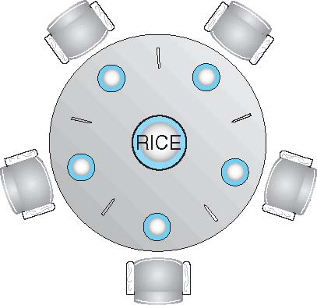
Dining-Philosophers Problem
Philosophers spend their lives alternating thinking and eating
They don’t interact with their neighbors, occasionally try to pick up 2 chopsticks (one at a time) to eat from bowl
  Need both to eat, then release both when done
In the case of 5 philosophers
  Shared data
    Bowl of rice (data set)
    Semaphore chopstick [5] initialized to 1

Slide 47
Dining-Philosophers Problem Algorithm
The structure of Philosopher i:
    do {
    wait (chopstick[i] );
    wait (chopStick[ (i + 1) % 5] );
    // eat
    signal (chopstick[i] );
    signal (chopstick[ (i + 1) % 5] );
    // think
    } while (TRUE);
What is the problem with this algorithm?
  Ans: Deadlock
  If all five philosophers become hungry at the same time and each grabs his/her left chopstick. All the elements of chopstick will now be equal to 0.
  When each philosopher tries to grab his/her right chopstick, he/she will be delayed forever.

Slide 48
Dining-Philosophers Problem Algorithm (Cont.)
Deadlock handling
  Allow at most 4 philosophers to be sitting simultaneously at the table.
  Allow a philosopher to pick up the forks only if both are available (picking must be done in a critical section).
  Use an asymmetric solution -- an odd-numbered philosopher picks up first the left chopstick and then the right chopstick. Even-numbered philosopher picks up first the right chopstick and then the left chopstick.

Slide 49
Problems with Semaphores
Incorrect use of semaphore operations:
  signal (mutex) …. wait (mutex)
  wait (mutex) … wait (mutex)
  Omitting of wait (mutex) or signal (mutex) (or both)
Deadlock and starvation are possible.

Slide 50
Monitors
A high-level abstraction that provides a convenient and effective mechanism for process synchronization
An Abstract data type, internal variables are only accessible by code within the procedure
Only one process may be active within the monitor at a time.
But not powerful enough to model some synchronization schemes, hence condition constructs are introduced.
    monitor monitor-name
    {
    // shared variable declarations
    procedure P1 (…) { …. }
    procedure Pn (…) {……}
    Initialization code (…) { … }
    }
    }

Slide 51
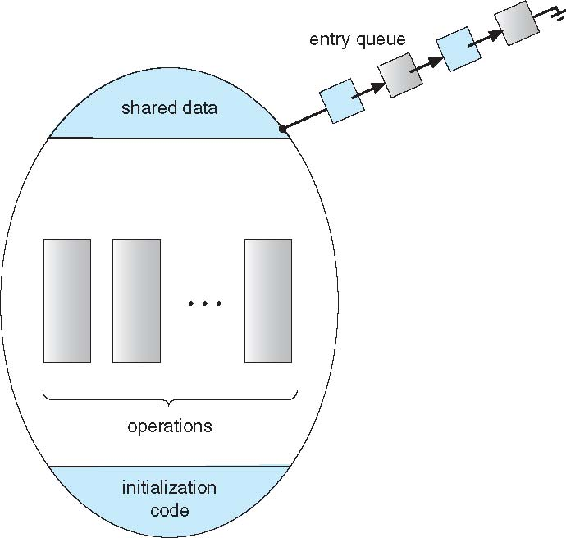
Schematic view of a Monitor

Slide 52
Condition Variables
condition x, y;
Two operations are allowed on a condition variable:
  x.wait() – a process that invokes the operation is suspended until x.signal()
  x.signal() – resumes one of processes (if any) that invoked x.wait()
    If no x.wait() on the variable, then it has no effect on the variable

Slide 53
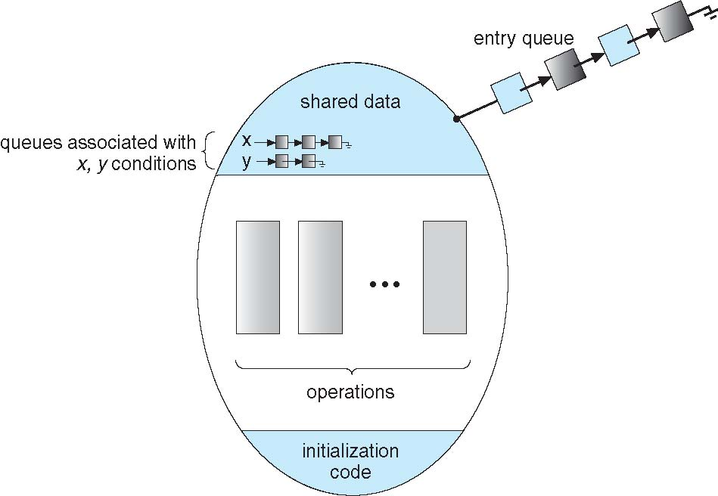
Monitor with Condition Variables

Slide 54
Condition Variables Choices
If process P invokes x.signal(), and process Q is suspended in x.wait(), what should happen next?
  Both Q and P cannot execute in parallel. If Q is resumed, then P must wait
Options include
  Signal and wait – P waits until Q either leaves the monitor or it waits for another condition
  Signal and continue – Q waits until P either leaves the monitor or it waits for another condition
  Both have pros and cons – language implementer can decide
  Monitors implemented in Concurrent Pascal compromise
    P executing signal immediately leaves the monitor, Q is resumed
  Implemented in other languages including Mesa, C#, Java

Slide 55
Monitor Solution to Dining Philosophers
monitor DiningPhilosophers
{
enum { THINKING, HUNGRY, EATING) state [5] ;
condition self [5];
void pickup (int i) {
state[i] = HUNGRY;
test(i);
if (state[i] != EATING) self[i].wait;
}
void putdown (int i) {
state[i] = THINKING;
// test left and right neighbors
test((i + 4) % 5);
test((i + 1) % 5);
}
void test (int i) {
if ((state[(i + 4) % 5] != EATING) &&
(state[i] == HUNGRY) &&
(state[(i + 1) % 5] != EATING) ) {
state[i] = EATING ;
self[i].signal () ;
}
}

Slide 56
Solution to Dining Philosophers (Cont.)
/*void test (int i) {
if ((state[(i + 4) % 5] != EATING) &&
(state[i] == HUNGRY) &&
(state[(i + 1) % 5] != EATING) ) {
state[i] = EATING ;
self[i].signal () ;
}
}
*/
initialization_code() {
for (int i = 0; i < 5; i++)
state[i] = THINKING;
}
}

Slide 57
Solution to Dining Philosophers (Cont.)
Each philosopher i invokes the operations pickup() and putdown() in the following sequence:
DiningPhilosophers.pickup(i);
EAT
DiningPhilosophers.putdown(i);
No deadlock, but starvation is possible

Slide 58
Examples
Sleeping Barber’s Problem
Cigarette Smoker’s Problem

Slide 59
Monitor Implementation Using Semaphores
Variables
semaphore mutex; // (initially = 1)
semaphore next; // (initially = 0)
int next_count = 0;
Each procedure F will be replaced by
wait(mutex);
…
body of F;
…
if (next_count > 0)
signal(next)
else
signal(mutex);
Mutual exclusion within a monitor is ensured

Slide 60
Monitor Implementation – Condition Variables
For each condition variable x, we have:
semaphore x_sem; // (initially = 0)
int x_count = 0;
The operation x.wait can be implemented as:
x_count++;
if (next_count > 0)
signal(next);
else
signal(mutex);
wait(x_sem);
x_count--;

Slide 61
Monitor Implementation (Cont.)
The operation x.signal can be implemented as:
if (x_count > 0) {
next_count++;
signal(x_sem);
wait(next);
next_count--;
}

Slide 62
Monitor Implementation Using Semaphores (All in one slide)
Variables
semaphore mutex; // (initially = 1)
semaphore next; // (initially = 0)
int next_count = 0;
Each procedure F will be replaced by
wait(mutex);
…
body of F;
…
if (next_count > 0)
signal(next)
else
signal(mutex);
Mutual exclusion within a monitor is ensured
For each condition variable x, we have:
semaphore x_sem; // (initially = 0)
int x_count = 0;
The operation x.wait can be implemented as:
x_count++;
if (next_count > 0)
signal(next);
else
signal(mutex);
wait(x_sem);
x_count--;
………………………………………………………………….
The operation x.signal can be implemented as:
if (x_count > 0) {
next_count++;
signal(x_sem);
wait(next);
next_count--;
}

Slide 63
Resuming Processes within a Monitor
If several processes queued on condition x, and x.signal() executed, which should be resumed?
FCFS frequently not adequate
conditional-wait construct of the form x.wait(c)
  Where c is priority number
  Process with lowest number (highest priority) is scheduled next

Slide 64
Single Resource allocation
Allocate a single resource among competing processes using priority numbers that specify the maximum time a process plans to use the resource
R.acquire(t);
...
access the resurce;
...
R.release;
Where R is an instance of type ResourceAllocator

Slide 65
A Monitor to Allocate Single Resource
monitor ResourceAllocator
{
boolean busy;
condition x;
void acquire(int time) {
if (busy)
x.wait(time);
busy = TRUE;
}
void release() {
busy = FALSE;
x.signal();
}
initialization code() {
busy = FALSE;
}
}

Slide 66
Synchronization Examples
Solaris
Windows
Linux
Pthreads

Slide 67
Solaris Synchronization
Implements a variety of locks to support multitasking, multithreading (including real-time threads), and multiprocessing
Uses adaptive mutexes for efficiency when protecting data from short code segments
  Starts as a standard semaphore spin-lock
  If lock held, and by a thread running on another CPU, spins
  If lock held by non-run-state thread, block and sleep waiting for signal of lock being released
Uses condition variables
Uses readers-writers locks when longer sections of code need access to data
Uses turnstiles to order the list of threads waiting to acquire either an adaptive mutex or reader-writer lock
  Turnstiles are per-lock-holding-thread, not per-object
Priority-inheritance per-turnstile gives the running thread the highest of the priorities of the threads in its turnstile

Slide 68
Windows Synchronization
Uses interrupt masks to protect access to global resources on uniprocessor systems
Uses spinlocks on multiprocessor systems
  Spinlocking-thread will never be preempted
Also provides dispatcher objects user-land which may act mutexes, semaphores, events, and timers
  Events
    An event acts much like a condition variable
  Timers notify one or more thread when time expired
  Dispatcher objects either signaled-state (object available) or non-signaled state (thread will block)

Slide 69
Linux Synchronization
Linux:
  Prior to kernel Version 2.6, disables interrupts to implement short critical sections
  Version 2.6 and later, fully preemptive
Linux provides:
  Semaphores
  atomic integers
  spinlocks
  reader-writer versions of both
On single-cpu system, spinlocks replaced by enabling and disabling kernel preemption

Slide 70
Pthreads Synchronization
Pthreads API is OS-independent
It provides:
  mutex locks
  condition variable
Non-portable extensions include:
  read-write locks
  spinlocks

Slide 71
Alternative Approaches
Transactional Memory
OpenMP
Functional Programming Languages

Slide 72
Transactional Memory
A memory transaction is a sequence of read-write operations to memory that are performed atomically.
void update()
{
/* read/write memory */
}

Slide 73
OpenMP
OpenMP is a set of compiler directives and API that support parallel progamming.
void update(int value)
{
#pragma omp critical
{
count += value
}
}
The code contained within the #pragma omp critical directive is treated as a critical section and performed atomically.

Slide 74
Functional Programming Languages
Functional programming languages offer a different paradigm than procedural languages in that they do not maintain state.
Variables are treated as immutable and cannot change state once they have been assigned a value.
There is increasing interest in functional languages such as Erlang and Scala for their approach in handling data races.

